Slide 1
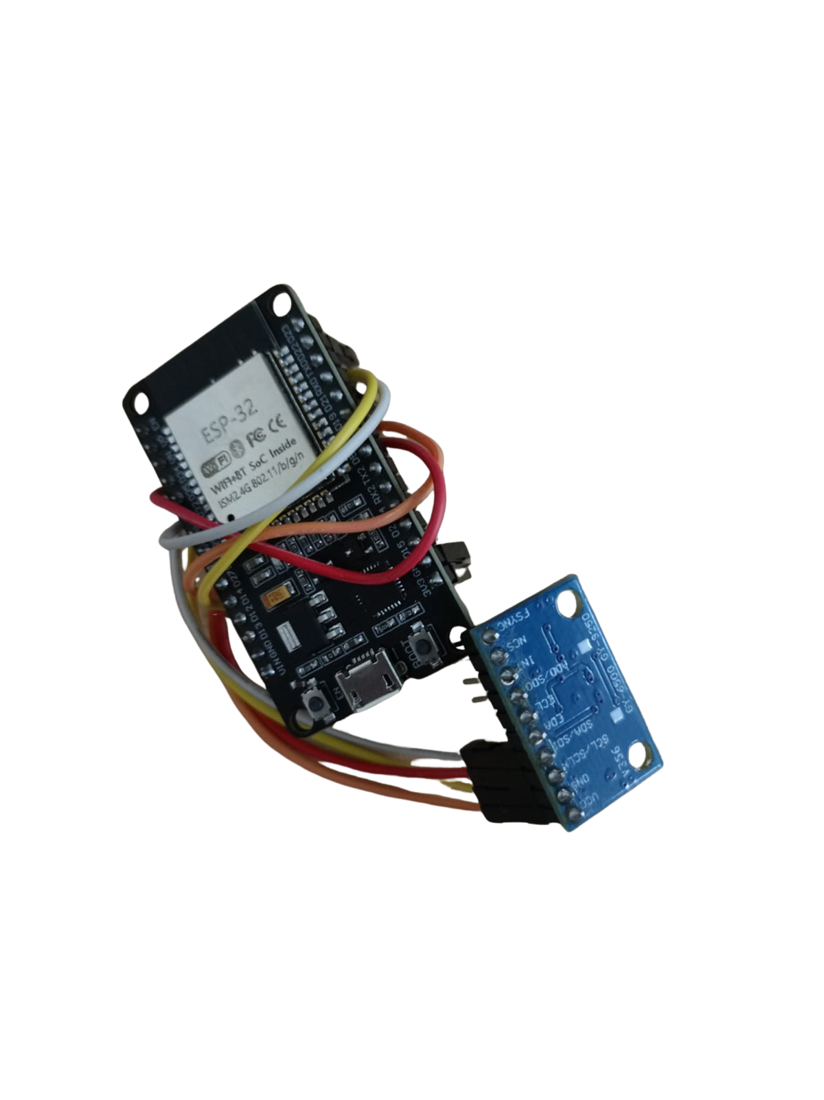
KneeGait-Edge
GRAVITON (CGC University Mohali)
Democratizing Gait Intelligence
A ₹516 edge-AI wearable for accessible gait analysis
Team Astronauts
Rahul Bansal (CTU)
Prateek Dhar Dwivedi (NIELIT Deemed to be University Ropar)
Saksham Verma (NIELIT Deemed to be University Ropar)
Krishna Kumar (NIELIT Deemed to be University Ropar)
Notes:
KneeGait-Edge is a low-cost wearable that brings gait screening out of the lab. One shank-mounted IMU, an ESP32 doing the processing and the machine learning on-device, and a browser dashboard over Bluetooth. Prototype cost: about ₹516.

Slide 2
Gait analysis is locked behind labs
THE ACCESS GAP
650M+
adults live with knee osteoarthritis worldwide
Traditional approach
Specialized equipment
Expensive infrastructure
Laboratory-dependent
Limited access
$20K–$50K
optical motion-capture systems (Vicon, Qualisys)
₹516
our single-IMU edge-AI prototype
Can gait intelligence become portable, accessible and affordable?
The need: Portable • Affordable • Real-time • Accessible
Notes:
Optical motion capture costs tens of thousands of dollars and lives in a lab. Knee osteoarthritis affects over 650 million adults, so the gap between who needs gait assessment and who can get it is large.

Slide 3




Meet KneeGait-Edge
THE PROTOTYPE
A wearable edge-AI prototype that tracks shank motion during walking with a single IMU strapped to the shin.
01 SENSE
02 COMPUTE
Shank IMU captures movement
ESP32 processes in real time
Mounted on the flat anteromedial tibia to limit soft-tissue wobble.
From body movement to real-time gait intelligence.
03 ANALYZE
04 VISUALIZE
Gait features are extracted
BLE streams to the browser
Notes:
Four stages: sense with the shank IMU, compute on the ESP32, analyze gait features, visualize in the browser over Web Bluetooth. Everything except the dashboard runs on the wearable.

Slide 4
From Motion to Gait Intelligence
SYSTEM FLOW
SHANK IMU
ESP32
SENSOR FUSION
STRIDE FEATURES
RANDOM FOREST
BLE DASHBOARD
RESEARCH BACKED
Bytyqi et al. (2014)
Rhudy et al. (2024)
Song & Baxter (2025)
Clinical thresholds
Sensor fusion
Placement & validation
Peak swing flexion ≈ 41.9° in medial knee OA vs ≈ 58° in healthy controls; basis for the < 45° screening flag.
Magnetometer-free complementary filter (α = 0.96 at 50 Hz); reported joint-angle RMSE ≤ 3.2° vs motion capture.
Tibia-mounted IMUs limit soft-tissue artifact; reported Rxy ≥ 0.90 against optical motion capture.
Literature figures come from knee-angle studies, not from this prototype's own measurements.
Notes:
The design choices trace back to three papers: Bytyqi for the clinical stiff-gait threshold, Rhudy for the complementary filter, Song and Baxter for tibial mounting. These are literature results, not our own validation.

Slide 5



Simple Hardware. Smart Processing.
HARDWARE
ESP32 NodeMCU
1 × MPU-6050
USB power bank
Elastic bandage
Processing + BLE
6-axis motion sensing on the shank
Portable power
Wearable mounting
I²C BUS
SDA → GPIO 21 SCL → GPIO 22 Shank IMU → 0x68 (AD0 low) / 0x69 (AD0 high)
Cost democratization: capable sensing from components anyone can buy.
₹516 prototype cost
Notes:
Four cheap parts. The MPU-6050 is on I2C (SDA GPIO 21, SCL GPIO 22). The address is 0x68 or 0x69 depending on the AD0 pin. The ₹516 figure is the out-of-pocket cost of this prototype.

Slide 6
Turning Raw Motion Into Shank Angle
SIGNAL FUSION
1
2
3
ACCELEROMETER TILT
GYROSCOPE INTEGRATION
COMPLEMENTARY FILTER
Inclination from gravity: atan2(−ax, √(ay²+az²))
Rotation over time: θ(t−Δt) + ω·Δt
Fused angle with less noise and drift
θ(t) = 0.96 × [θ(t−Δt) + ω·Δt] + 0.04 × θacc(t)
50 Hz sampling • Δt = 20 ms • α = 0.96
One IMU gives shank inclination θshank, a proxy for knee motion. True knee flexion, |θthigh − θshank|, needs a second (thigh) sensor, which is planned next.
Notes:
A complementary filter blends the gyroscope (smooth but drifts) with accelerometer tilt (noisy but drift-free). With 96% weight on the gyro path at 50 Hz it is cheap enough for the ESP32. With one shank sensor the output is shank angle, not knee flexion.

Slide 7
From Strides to Features
GAIT ANALYSIS
HEEL-STRIKE EVENT DETECTION
FIVE GAIT FEATURES PER STRIDE
≥ 1.45 g
1
Peak swing angle
Max shank angle during the swing phase
Shank impact spike marks a heel strike
2
Sagittal range of motion
Max − min angle across the stride
0.40 s
3
Stance / swing ratio
Refractory window rejects bounce and chatter
Weight-bearing time ÷ swing time
4
Peak angular velocity
0.55–2.40 s
Max rate of rotation, max |dθ/dt|
Valid stride duration (physiological bounds)
5
Cadence
Steps per minute = 120 ÷ stride time (s)
Notes:
Strides are cut at heel strikes, detected from the shank acceleration spike. Each stride yields five features that feed the classifier.

Slide 8
Intelligence at the Edge
EDGE AI
RAW 50 Hz SHANK DATA
3-CLASS RISK OUTPUT
Normal gait
STRIDE SEGMENTATION
Peak swing flexion ≥ 49.4° · continue monitoring
Mild functional restriction
5 GAIT FEATURES
45.0° ≤ peak swing flexion < 49.4° · follow up
Severe antalgic stiff gait
RANDOM FOREST (20 TREES, DEPTH 5)
Peak swing flexion < 45.0° · physician review
Random Forest → portable C header → ESP32 inference. No cloud needed for core inference.
ON-DEVICE INFERENCE (< 50 µs)
Trained on 20,000 synthetic strides; thresholds are knee-flexion references. Validation on real gait data is a next step.
Notes:
The classifier is a small random forest exported as a C header, so inference runs on the ESP32 in microseconds with no cloud. Important caveat: the training data is synthetic, and the class thresholds come from knee-flexion literature, so real-data validation is required.

Slide 9


See the Gait in Real Time
LIVE EXPERIENCE
Web Bluetooth
Runs in Chrome or Edge, no app install
Risk badge
Green / amber / red triage at a glance
Reports
Session analytics, CSV export, printable PDF
Illustrative waveform; not patient data.
Notes:
The dashboard talks to the ESP32 over Web Bluetooth, so there is no backend or app to install. The waveform shown is illustrative.

Slide 10
From Movement to Meaning
BIOMECHANICAL CONTEXT
≈ 58°
41.9°
< 45°
Healthy mean peak swing flexion (Bytyqi 2014)
Mean in moderate-to-severe medial knee OA
Screening flag for stiff-gait risk, not a diagnosis
GAIT CYCLE
1 STANCE
2 TOE-OFF
3 MID-SWING
4 HEEL STRIKE
Research / hackathon prototype, not intended for medical diagnosis. Shank-only angles are a proxy for knee flexion, so thresholds need recalibration on real data.
Notes:
Patients with knee OA tend to stiffen the knee during swing, reducing peak flexion. The < 45° line is a screening indicator from the literature, not a diagnosis, and our shank-only angle is a proxy that needs recalibration.

Slide 11
From Prototype to Scalable Gait AI
ROADMAP
NOW
NEXT
FUTURE
₹516 prototype
Single shank IMU
ESP32 edge AI
BLE web dashboard
Add thigh IMU for true knee flexion
Real gait data and model validation
Compare with optical capture
Improved enclosure
Clinical validation
Bilateral left/right nodes
Insole force sensors
Cloud / EHR telehealth
POTENTIAL APPLICATIONS
Research • Physiotherapy support • Gait screening • Remote monitoring • Resource-constrained settings
Notes:
Next step with the biggest impact: add the thigh IMU so the device measures true knee flexion and the literature thresholds apply directly, then collect real gait data to replace the synthetic training set.

Slide 12
References & Acknowledgements
CREDITS
Note: this is a hackathon/research prototype. Dashboard values shown are illustrative, not patient results.
RESEARCH REFERENCES
Bytyqi, D., Shabani, B., Lustig, S., Cheze, L., Gjurgjeala, N. K., & Neyret, P. (2014). Gait knee kinematic alterations in medial osteoarthritis: Three-dimensional assessment. International Orthopaedics, 38(6), 1191–1198. https://doi.org/10.1007/s00264-014-2312-3
Rhudy, M. B., Mahoney, J. M., & Altman-Singles, A. R. (2024). Knee angle estimation with dynamic calibration using inertial measurement units for running. Sensors, 24(2), 695. https://doi.org/10.3390/s24020695
Song, K., & Baxter, J. R. (2025). Body-worn inertial measurement units track knee flexion angles with similar accuracy to optical motion capture. medRxiv. https://doi.org/10.1101/2025.10.20.25338317
Espressif Systems. (2023). ESP32 Low-Power Management and RF Power Consumption Specification. Espressif Architecture Documentation, Rev. 3.4.
Democratizing Gait Intelligence.
Notes:
Reiterate the prototype status and that dashboard values are illustrative.

